Slide 1
SC2001
Project 3
SCS5 Team 1
Kiersten, Nicholas, Mythili

Slide 2
Table of contents
01
02
03
04
Recursive definition
Subproblem graph
Dynamic programming algorithm
Coded algorithm

Slide 3

01
Recursive definition

Slide 4
Problem Summary
Crux : unlimited copies of each object
For the n^{th} object there's two options: > choose it : in which case the profit of the object is added to the subproblem where the capacity decreases with the kind of available objects still being n > don’t choose it : the profit is equal to that of the subproblem where the capacity doesn’t change, but the number of kind of objects you consider decreases by one (you move on to the n-1th object)
Problem: Given a knapsack of capacity C, and infinite copies of n different objects each with a weight and profit, choose objects to put in the bag, not exceeding the capacity while maximising profit.
Notes:
Hence, you can keep choosing one object over and over.
Current profit depends on profit of subproblems, for current profit to be maximum, the solution of the subproblems should also be optimal .
Hence the principle of optimality holds and we can move to the recursive definition

Slide 5
Recursive Definition
Recursive Definition: Profit(c,n) = max (P_{n} + Profit(c-W_{n}, n), Profit(c, n-1))
Base case:
Profit(0, n) = 0
Profit(c, 0) = 0
^
^
|
|
choose
don’t choose

Slide 6
02
Subproblem graph

Slide 7
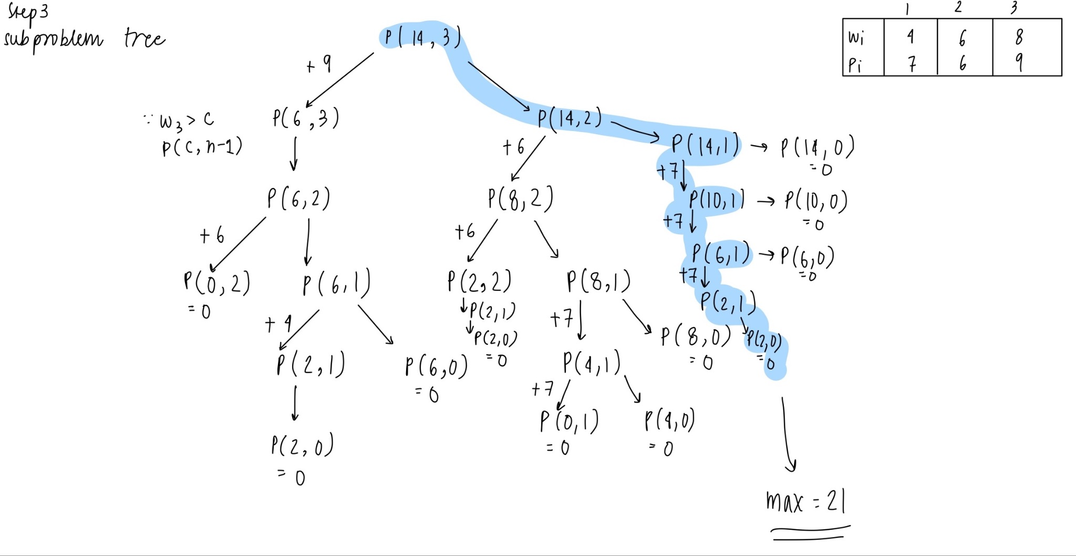

Slide 8
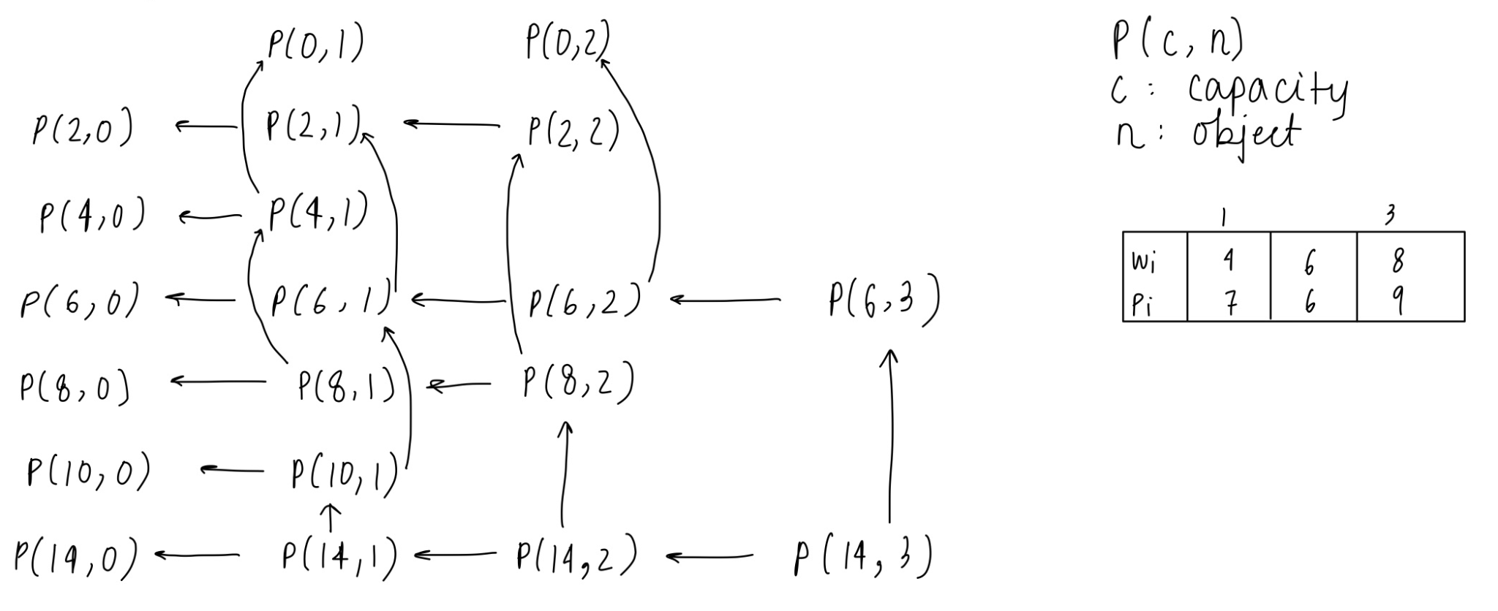
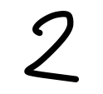
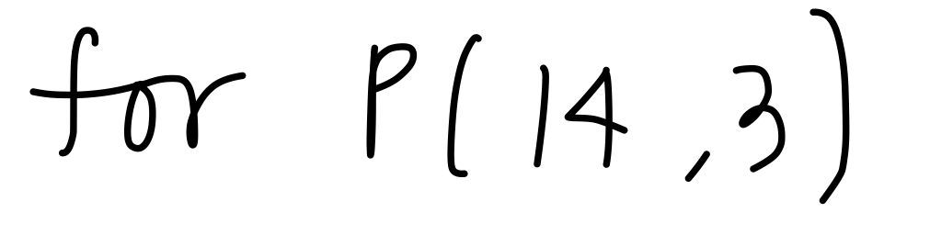

Slide 9
03
Dynamic programming algorithm

Slide 10
Input
weights : array containing the weights of n items
profits : array containing the profits of n items
capacity : maximum capacity of the knapsack

Slide 11
Algorithm
Create a 1D-Array (table), length = capacity
> Initialise all elements to 0
Iterate through items from 0 to n-1
For each item, iterate over possible capacities from 1 to capacity
If weight <= capacity, take maximum profit
> Option 1 : Include item (profits[i] + table[j - weights[i]])
> Option 2 : Exclude item (table[j])
At the end, table[capacity] will contain the maximum profit that can be obtained
Notes:
Mention that the table is meant to hold the max profit at each capacity

Slide 12
Why a 1D-Array instead of 2D
There is no limit on the number of items
The array stores the maximum profit for each capacity
Every iteration we consider one more item
At the start of the i^{th} iteration, the value at table[k] = max profit for capacity k when chosen from the first i-1 objects
In this iteration, if we decide to choose the i^{th} object for capacity k, we need the value for the max profit for capacity k-weight[i], with i objects which has already been calculated in this iteration
If it is not chosen, the max profit remains the same

Slide 13
04
Coded algorithm

Slide 14
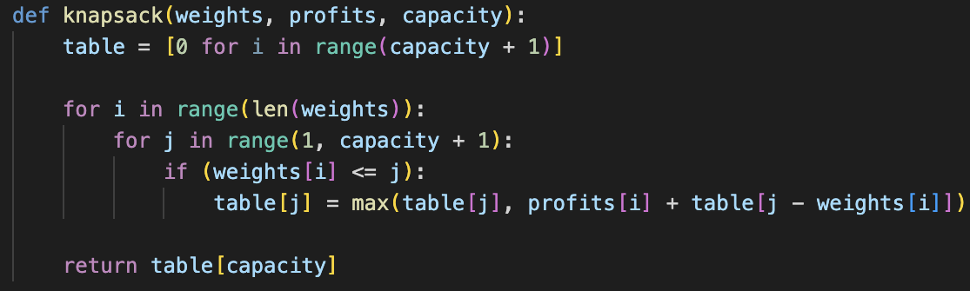

Slide 15
Thank you!

